Slide 1
Dashboard and blending
File created on: 1/27/21 11:36:46 AM EST

Slide 2
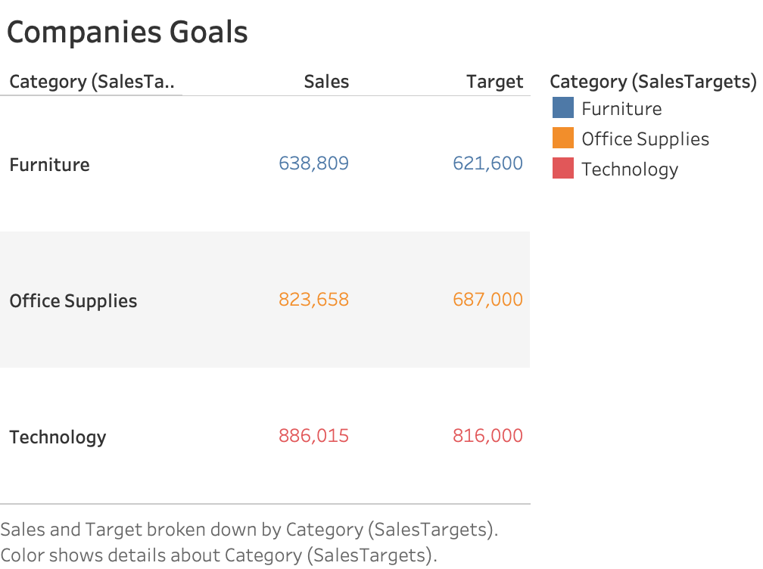

Slide 3
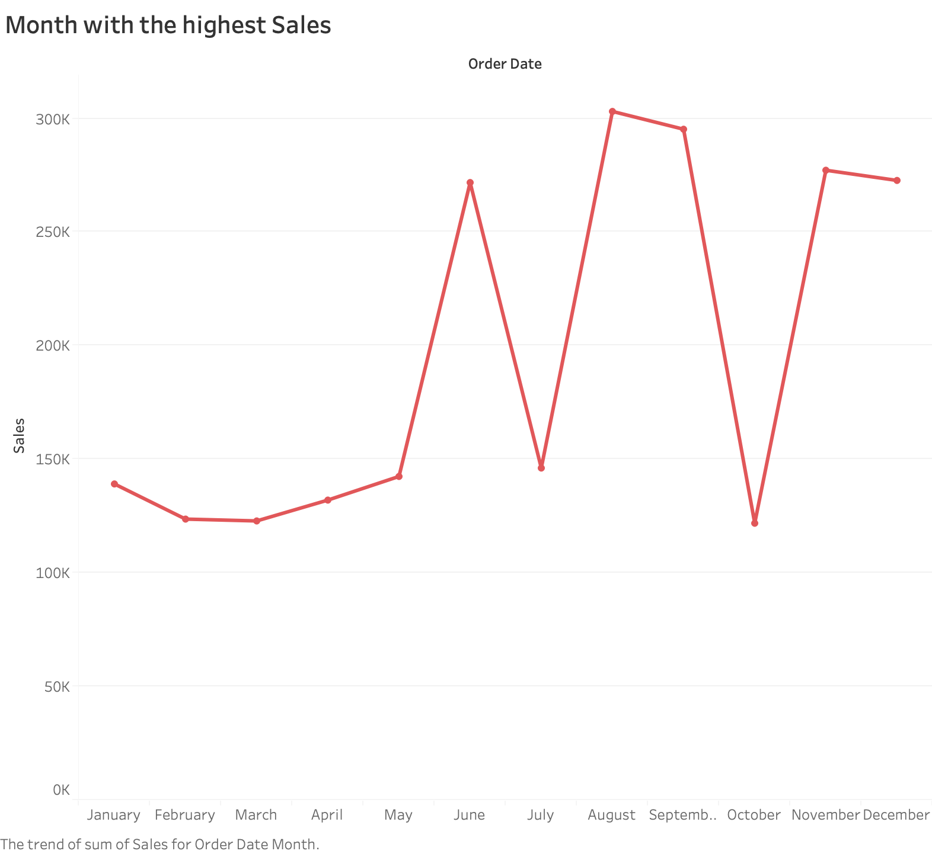

Slide 4
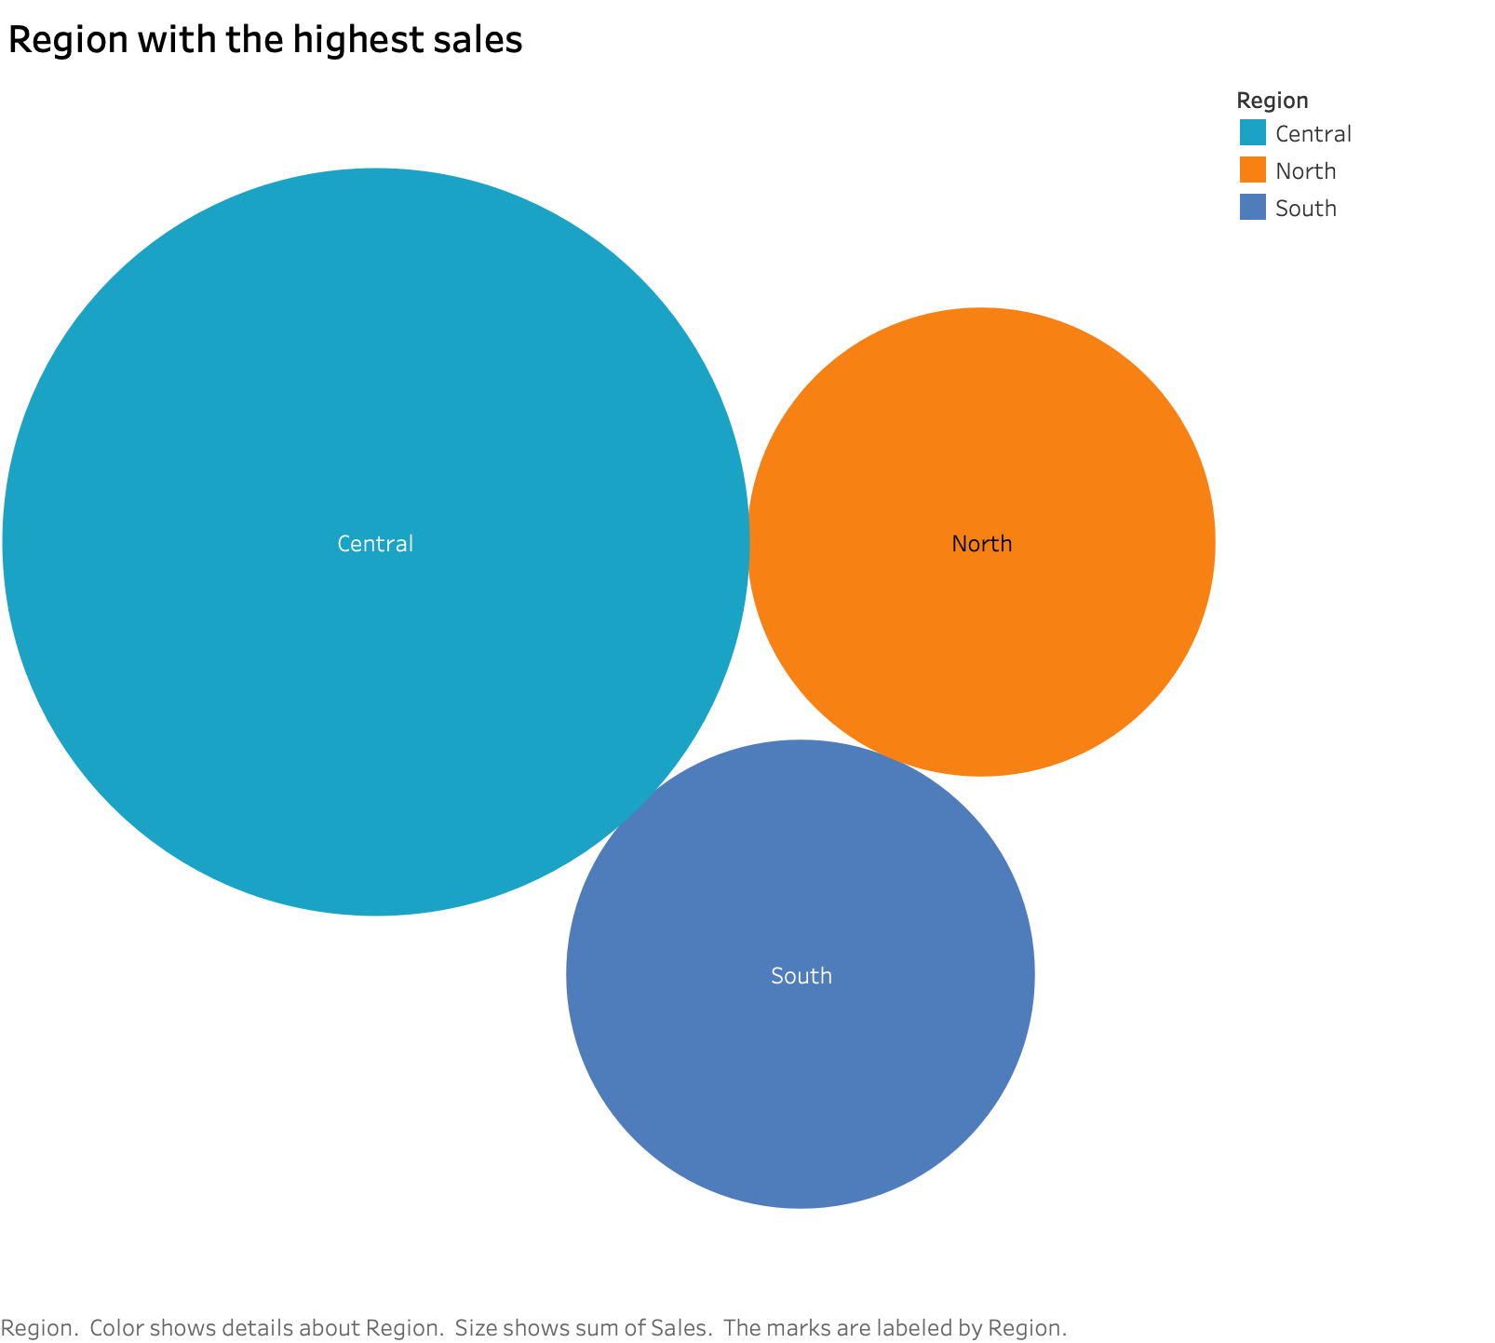

Slide 5
